Slide 1
Computer Networks CS 3001 (BCS-5B) Lecture 4
Danyal Farhat
FAST School of Computing
NUCES Lahore

Slide 2

Chapter 4 Network Layer:
Data Plane
A note on the use of these PowerPoint slides:
We’re making these slides freely available to all (faculty, students, readers). They’re in PowerPoint form so you see the animations; and can add, modify, and delete slides (including this one) and slide content to suit your needs. They obviously represent a lot of work on our part. In return for use, we only ask the following:
If you use these slides (e.g., in a class) that you mention their source (after all, we’d like people to use our book!)
If you post any slides on a www site, that you note that they are adapted from (or perhaps identical to) our slides, and note our copyright of this material.
For a revision history, see the slide note for this page.
Thanks and enjoy! JFK/KWR
All material copyright 1996-2020
J.F Kurose and K.W. Ross, All Rights Reserved
Computer Networking: A Top-Down Approach 8th edition Jim Kurose, Keith Ross Pearson, 2020

Slide 3
Network layer: our goals
understand principles behind network layer services, focusing on data plane:
network layer service models
forwarding versus routing
how a router works
addressing
generalized forwarding
Internet architecture
instantiation, implementation in the Internet
IP protocol
NAT, middleboxes

Slide 4

Network layer: “data plane” roadmap
Network layer: overview
data plane
control plane
What’s inside a router
input ports, switching, output ports
buffer management, scheduling
IP: the Internet Protocol
datagram format
addressing
network address translation
IPv6
Generalized Forwarding, SDN
Match+action
OpenFlow: match+action in action
Middleboxes

Slide 5








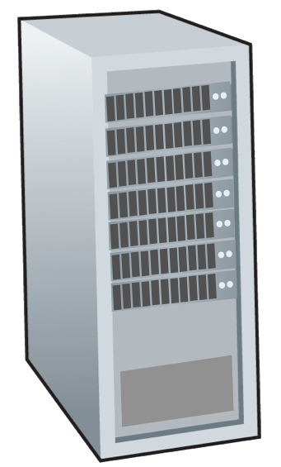







Network-layer services and protocols
transport segment from sending to receiving host
sender: encapsulates segments into datagrams, passes to link layer
receiver: delivers segments to transport layer protocol
network layer protocols in every Internet device: hosts, routers
routers:
examines header fields in all IP datagrams passing through it
moves datagrams from input ports to output ports to transfer datagrams along end-end path
mobile network
national or global ISP
application
transport
network
link
physical
network
link
physical
network
link
physical
network
link
physical
network
link
physical
network
link
physical
datacenter
network
application
transport
network
link
physical
enterprise
network

Slide 6

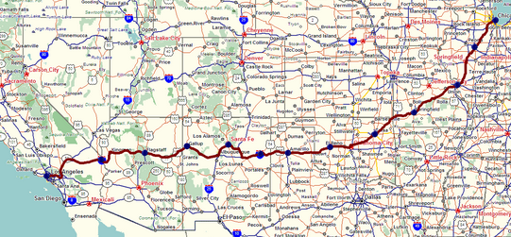
Two key network-layer functions
network-layer functions:
forwarding: move packets from a router’s input link to appropriate router output link
analogy: taking a trip
forwarding: process of getting through single interchange
routing: process of planning trip from source to destination
routing: determine route taken by packets from source to destination
routing algorithms
forwarding
routing

Slide 7
Network layer: data plane, control plane
Data plane:
local, per-router function
determines how datagram arriving on router input port is forwarded to router output port
Control plane
network-wide logic
determines how datagram is routed among routers along end-end path from source host to destination host
values in arriving
packet header
two control-plane approaches:
traditional routing algorithms: implemented in routers
software-defined networking (SDN): implemented in (remote) servers
0111
1
3
2

Slide 8

Per-router control plane
Individual routing algorithm components in each and every router interact in the control plane
Routing
Algorithm
control
plane
data
plane
values in arriving
packet header
0111
1
3
2

Slide 9
Software-Defined Networking (SDN) control plane
Remote controller computes, installs forwarding tables in routers
Remote Controller
control
plane
data
plane
CA
CA
CA
CA
CA
values in arriving
packet header
0111
1
3
2

Slide 10
Network service model
Q: What service model for “channel” transporting datagrams from sender to receiver?
example services for individual datagrams:
guaranteed delivery
guaranteed delivery with less than 40 msec delay
example services for a flow of datagrams:
in-order datagram delivery
guaranteed minimum bandwidth to flow
restrictions on changes in inter-packet spacing

Slide 11
Network-layer service model
Quality of Service (QoS) Guarantees ?
Network
Architecture
Internet
ATM
ATM
Internet
Internet
Service
Model
best effort
Constant Bit Rate
Available Bit Rate
Intserv Guaranteed
(RFC 1633)
Diffserv (RFC 2475)
Bandwidth
none
Constant rate
Guaranteed min
yes
possible
Loss
no
yes
no
yes
possibly
Order
no
yes
yes
yes
possibly
Timing
no
yes
no
yes
no
Internet “best effort” service model
No guarantees on:
successful datagram delivery to destination
timing or order of delivery
bandwidth available to end-end flow

Slide 12
Network-layer service model
Quality of Service (QoS) Guarantees ?
Network
Architecture
Internet
ATM
ATM
Internet
Internet
Service
Model
best effort
Constant Bit Rate
Available Bit Rate
Intserv Guaranteed
(RFC 1633)
Diffserv (RFC 2475)
Bandwidth
none
Constant rate
Guaranteed min
yes
possible
Loss
no
yes
no
yes
possibly
Order
no
yes
yes
yes
possibly
Timing
no
yes
no
yes
no

Slide 13
Reflections on best-effort service:
simplicity of mechanism has allowed Internet to be widely deployed adopted
sufficient provisioning of bandwidth allows performance of real-time applications (e.g., interactive voice, video) to be “good enough” for “most of the time”
replicated, application-layer distributed services (datacenters, content distribution networks) connecting close to clients’ networks, allow services to be provided from multiple locations
congestion control of “elastic” services helps
It’s hard to argue with success of best-effort service model

Slide 14
Thank You!

